Slide 1
Certified Kubernetes Administrator
Nobelprog
13-May-2024 – 15-May-2024

Slide 2
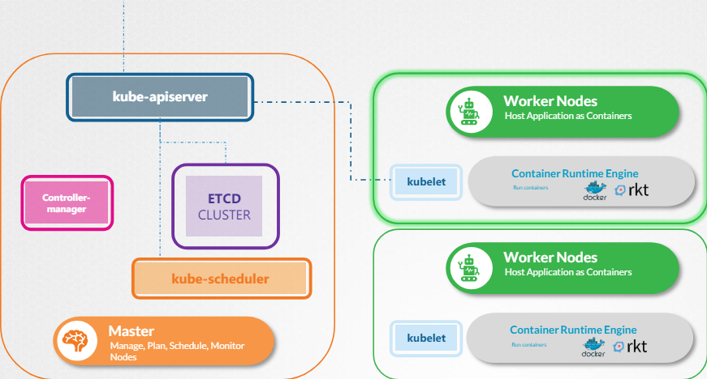
Cluster Architecture

Slide 3
ETCD in Kubernetes
ETCD is a distributed, reliable, key-value store that is simple, secure, and fast
The etcd data store stores information regarding the cluster such as the nodes, pods, configs, secrets, accounts, roles, role bindings, and others
- Version 2 commands: etcdctl backup, etcdctl cluster-health, etcdctl set, etcdctl set, etcdctl ge
- version 3 - etcdctl snapshot save, etcdctl endpoint health, etcdctl get, etcdctl put

Slide 4
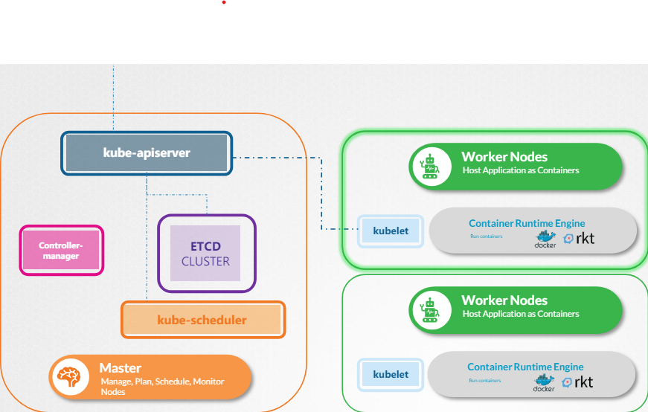
Kube-API server

Slide 5
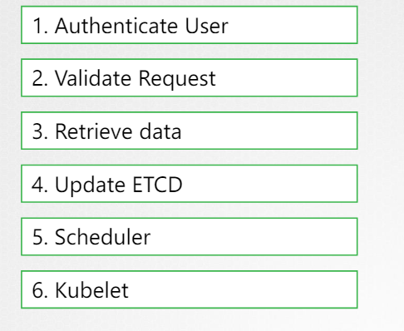
Kube-API server

Slide 6
Kube-API Server
The API server creates a pod object without assigning it to a node. Updates the information in the etcd server,updates the user that the pod has been created
The scheduler continuously monitors the API server and realizes that there is a new pod with no node assigned. The scheduler identifies the right node to place the new pod on and communicates that back to the kube-apiserver
The API server then updates the information in the etcd cluster
The API server then passes that information to the kubelet in the appropriate worker node

Slide 7
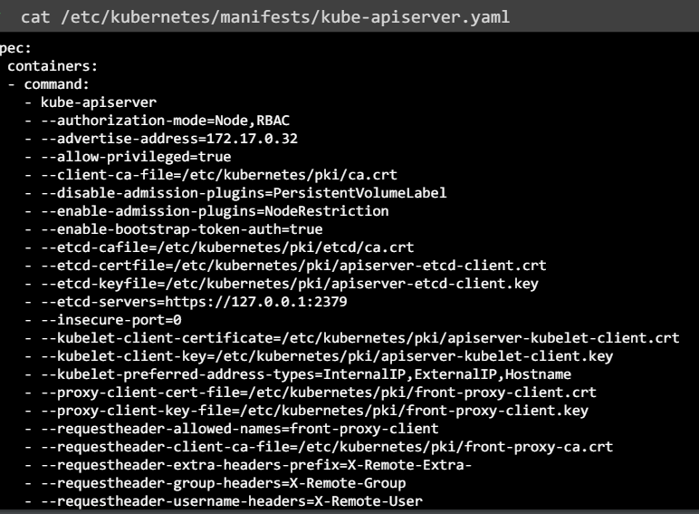
Kube-API Server

Slide 8
Kube Controller-Manager
Kube controller manager, manages various controllers in Kubernetes
Controller is a process that continuously monitors the state of various components within the system and works towards bringing the whole system to the desired functioning state
For example, the node controller is responsible for monitoring the status of the nodes and taking necessary actions to keep the applications running

Slide 9
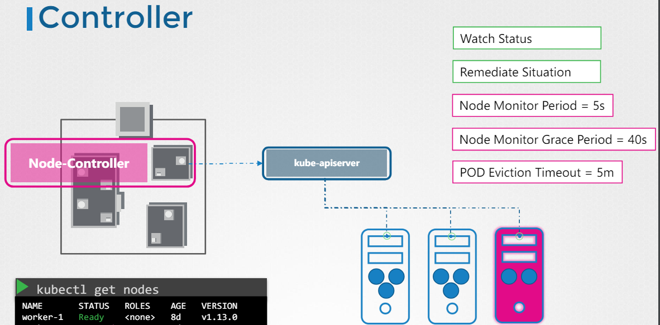
Node Controller

Slide 10
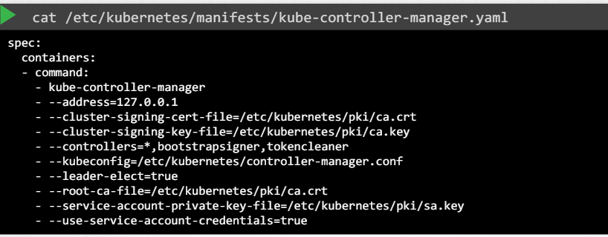
Kube Controller-Manager

Slide 11
Kube Scheduler
The Kubernetes scheduler is responsible for scheduling pods on nodes
scheduler is only responsible for deciding which pod goes on which node.It doesn't actually place the pod on the nodes. That's the job of the kubelet
You may have pods with different resource requirements.It may have a set of CPU and memory requirements
The scheduler ranks the nodes to identify the best fit for the pod. It uses a priority function to assign a score to the nodes on a scale of zero to 10

Slide 12
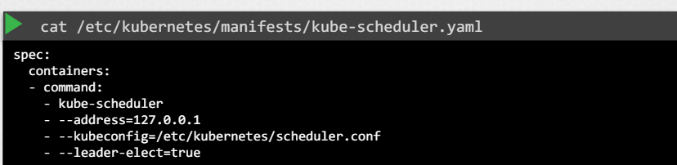
Kube Scheduler

Slide 13
Kubelet
The kubelet in the Kubernetes worker node registers the node with a Kubernetes cluster
The kubelet continues to monitor the state of the pod and containers in it and reports to the kube API server on a timely basis
If you use the kubeadm tool to deploy your cluster,it does not automatically deploy the kubelet

Slide 14
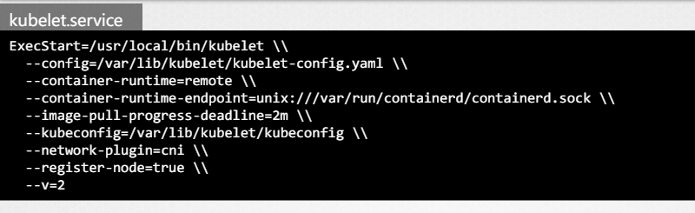
Kubelet

Slide 15
Kube proxy
Kube-proxy is a process that runs on each node in the Kubernetes cluster
Its job is to look for new services, and every time a new service is created, it creates the appropriate rules on each node to forward traffic on those services to the pods
Kube-proxy is deployed as a DaemonSet, so a single pod is always deployed on each node in the cluster

Slide 16
PODs
Kubernetes does not deploy application containers directlyon the worker nodes.
The containers are encapsulated into a Kubernetes object known as pods
pods usually have a one-to-one relationship with the containers but a single pod can have multiple containers
Deploy a pod: kubectl run nginx --image nginx

Slide 17
Creating PODs declaratively
Kubernetes uses YAML files as inputs for the creation of objects such as pods, replicas, deployments, services etc
4 top level fields in every yaml are the API version, kind, metadata, and spec
apiVersion: This is the version of the Kubernetes API
kind: type of the object (pod,replica-set,deployment,service etc)
metadata: data about the object like its name, labels etc. Its a disctionary
spec: The specification section which is written as spec. Depending on the object we are going to create, this is where we would provide additional information to Kubernetes pertaining to that object

Slide 18
Replica sets
Controllers are the brain behind Kubernetes. They are the processes that monitor Kubernetes objects and respond accordingly
The Replication Controller helps us run multiple instances of a single pod in the Kubernetes cluster,thus providing high availability
Replication Controller is the older technology that is being replaced by Replica Set
version in replication controller is v1 vs apps/v1 in replica set

Slide 19
Replica sets
version in replication controller is v1 vs apps/v1 in replica set
kind in replication controller is ReplicationController vs ReplicaSet in replica set
template is same for both but selector is optional in replication controller but mandatory in replica set
The selector section helps the Replica Set identify what pods fall under it
Upgrade replica set kubectl scale --replicas=6 replicaset myapp-replicaset

Slide 20
Deployment
Deployment is a Kubernetes object that comes higher in the hierarchy of replica set and pods
The deployment provides us with the capability to upgrade the underlying instances seamlessly using rolling updates, undo changes, and pause, and resume changes as required
Imperative creation: kubectl create deployment --image=httpd:1.4-alpine httpd-frontend --replicas=3
To edit the deployment: kubectl edit deployment web-app

Slide 21
Services: Nodeport
Kubernetes Services enable communication between various components within and outside of the application
NodePort service is the service that listens to a port on the node and forward request to the Pods
The service is like a virtual server inside the node. Inside the cluster it has its own IP address called ClusterIP of service
target port is the port on the Pod where the actual container is running
The second port is the port on the service itself
Finally, node port is the port on the node itself
When pods are distributed across multiple nodes k8s creates a service which spans across all the nodes

Slide 22
Service: ClusterIP
We cannot rely on these IP addresses for internal communication between the applications because IP address assigned to PODs can change
A Kubernetes ClusterIP service helps us group the pods together and provide a single interface to access the pods in a group
This enables us to easily and effectively deploy a microservices based application on Kubernetes cluster

Slide 23
Services: Nodeport
Kubernetes Services enable communication between various components within and outside of the application
NodePort service is the service that listens to a port on the node and forward request to the Pods
The service is like a virtual server inside the node. Inside the cluster it has its own IP address called ClusterIP of service
target port is the port on the Pod where the actual container is running
The second port is the port on the service itself
Finally, node port is the port on the node itself
When pods are distributed across multiple nodes k8s creates a service which spans across all the nodes

Slide 24
Service: LoadBalancer
To load balance requests on the all nodes in the cluster where pods are running
Only usable on cloud platforms with support of native load balancer (eg AWS, GCP, Azure etc)
Service definition is similar to NodePort except type: LoadBalancer

Slide 25
Namespace
Whatever Kubernetes objects we created such as pods, deployments, and services in our cluster. we have been doing all this within a name space. This name space is known as the default name space
Kubernetes creates a set of pods and services for its internal purpose
To isolate these from the user and to prevent you from accidentally deleting or modifying these services, Kubernetes creates them under another name space created at cluster startup named kube-system
One example of using a namespace is if you wanted to use the same cluster for both dev and production environment,but at the same time, isolate the resources between them

Slide 26
Namespace
You can also assign quota of resources to each of these name spaces. That way, each name space is guaranteed a certain amount and does not use more than its allowed limit
the resources within a name space can refer to each other simply by their names
kubectl get pods --namespace=kube-system
To switch to a different namespace: kubectl config set-context $(kubectl config current-context) --namespace=dev
To get pods from all namespace: kubectl get pods --all-namespaces

Slide 27
Scheduling: Manual scheduling
To manually schedule a pod is to simply set the node name field to the name of the node in your pod specification file while creating the pod
You can only specify the node name at creation time
Kubernetes won't allow you to modify the node name property of a pod

Slide 28
Labels and Selectors
Labels and selectors are a standard method to group things together
Labels are properties attached to each item, Selectors help you filter these items
We can create a lot of different types of objects in Kubernetes pods, services, replica sets, deployments etc. Then you will need a way to filter and view different objects by different categories
kubectl get pod --selector tier=frontend,env=prod,bu=finance
kubectl get all --selector env=prod

Slide 29
Taints and Tolerations
Taints and Tolerations tells the node to only accept pods with certain tolerations
We may have dedicated resources on a node for a particular use case or application
By placing a taint on the node, it prevent any pod from being placed on the node
To enable certain pods to be placed on this node, We must specify which pods are tolerant to this particular taint.
kubectl taint nodes node-name app=blue:taint-effect(NoSchedule|PreferNoSchedule|NoExecute)
Remove Taint: kubectl taint nodes controlplan app=blue:NoSchedule-

Slide 30
Node selector
we can set a limitation on the pods so that they only run on particular nodes (for example larger nodes with more compute power or resources)
Node selector is simple and easy way of doing this
To label a node: kubectl label nodes node01 size=Large

Slide 31
Node Affinity
We cannot provide advanced expressions like "or" or "not" with node selectors.
The node affinity feature provides us with advanced capabilities to limit pod placement on specific nodes
There are currently two types of node affinity available
requiredDuringSchedulingIgnoredDuringExecution
preferredDuringSchedulingIgnoredDuringExecution
For required type if a matching node is not found, pod is not scheduled
For preferred type if a matching node is not found, pod is scheduled on any node availabel

Slide 32
Resource Requirements and Limits
you can specify the amount of CPU and memory required for a pod when creating one, and this is known as the resource request for a container
By default, a container has no limit to the resources it can consume on a node. However, you can set a limit for the resource usage on these pods
A container cannot use more CPU resources than its limit. However, this is not the case with memory. A container can use more memory resources than its limit

Slide 33
Resource Requirements and Limits
Kubernetes does not have default resource requests or limits configured for every pod in cluster
we can ensure that every pod created has some default set
This is possible with limit ranges. LimitRange is applicable at the namespace level
If you create or change a limit range, it does not affect existing pods. It'll only affect newer pods that are created
If we had to say that all the pods together shouldn't consume more than this much of CPU or memory then we could create quotas at a namespace level

Slide 34
DaemonSets
DaemonSets are like ReplicaSets, as in it helps you deploy multiple instances of pods. But it runs one copy of your pod on each node in your cluster
Say you would like to deploy a monitoring agent or log collector on each of your nodes in the cluster,so you can monitor your cluster better
The kube-proxy component can be deployed as a DaemonSet in the cluster

Slide 35
Static PODs
Static Pods are created by the kubelet on its own without the intervention from the API server or rest of the Kubernetes cluster components are known as static Pods
You can only create Pods this way. You cannot create replica sets or deployments or services
You can configure the kubelet to read the Pod definition files from a directory on the server designated to store information about Pod

Slide 36
Static PODs
When the kubelet creates a static Pod, if it is a part of a cluster, it also creates a mirror object in the kube-apiserver
Kube-apiserver can view details about the Pod,but you cannot edit or delete it like the usual Pods
Since static Pods are not dependent on the Kubernetes control plane, you can use static Pods to deploy the control plane components itself as Pods on a Node
That's how the kube admin tool sets up a Kubernetes cluster

Slide 37
Logging and Monitoring
kubectl top node command provides the CPU and memory consumption of each of the node.
kubectl top pod command to view performance metrics of pods in Kubernetes.
Kubernetes does not come with a full-featured built-in monitoring solution. However, there are a number of open-source solutions available today uch as Metrics Server, Prometheus, the Elastic Stack, and proprietary solutions like Datadog and Dynatrace
kubectl logs -f pod-name [container-name]

Slide 38
Rolling updates and Rollbacks
When you first create a deployment, it triggers a rollout. A new rollout creates a new deployment revision. In the future when the application is upgraded,a new rollout is triggered, and a new deployment revision is created.
There are two types of deployment strategies, first is the recreate strategy, destroy all of these and then create newer versions of application instances
Other one is Rolling update, the default deployment strategy. In this strategy k8s take down the older version and bring up a newer version one by one.This way, the application never goes down

Slide 39
Rolling updates and Rollbacks
Rolling update strategies can also be seen when you view the deployments in detail. Run the kubectl describe deployment command to see the detailed information regarding the deployments
Under the hood. When a new deployment is created, say, to deploy five replicas,it first creates a replica set automatically, which in turn creates the number of pods required to meet the number of replicas

Slide 40
Commands, Arguments, Env Variables
In POD Definition command field overrides the ENTRYPOINT and args field overrides the CMD
To set an environment variable, use the ENV property. ENV is array, so every item under the ENV property is name and value
When a pod is created, inject the config map into the pod so the key value pairs are available as environment variables
Imperative way: kubectl create configmap appp-config --from-literal=APP_COLOR=blue \ --from-literal=APP_MOD=prod

Slide 41
Configuring ConfigMaps
We can take variable information out of the pod definition file and manage it centrally using configuration maps
Config maps are used to pass configuration data in the form of key value pairs in Kubernetes
When a pod is created, inject the config map into the pod so the key value pairs are available as environment variables

Slide 42
Configuring secrets in application
Secrets are used to store sensitive information like passwords or keys. They're similar to ConfigMaps except that they're stored in an encoded format
To encode in linux: echo -n "mysql" | base64
Imperative ways to create secrets: kubectl create secret generic app-secret --from-literal=DB_HOS=mysql
You can inject secrets in POD same as ConfigMaps

Slide 43
Multicontainer PODs
You have multi container pods that share the same life cycle
All pods in a container are created together and destroyed together. They share the same network space, which means they can refer to each other as local host, and they have access to the same storage volumes
To create a multi-container pod, add the new container information to the pod definition file. As container section under spec is an array
In a multi-container pod, each container is expected to run a process that stays alive as long as the POD's lifecycle

Slide 44
Init Containers
At times you may want to run a process that runs to completion in a container. For example a process that pulls a code or binary from a repository that will be used by the main web application
An initContainer is configured in a pod like all other containers, except that it is specified inside a initContainers section
When a POD is first created the InitContainer is run, and the process in the initContainer must run to a completion before the real container hosting the application starts

Slide 45
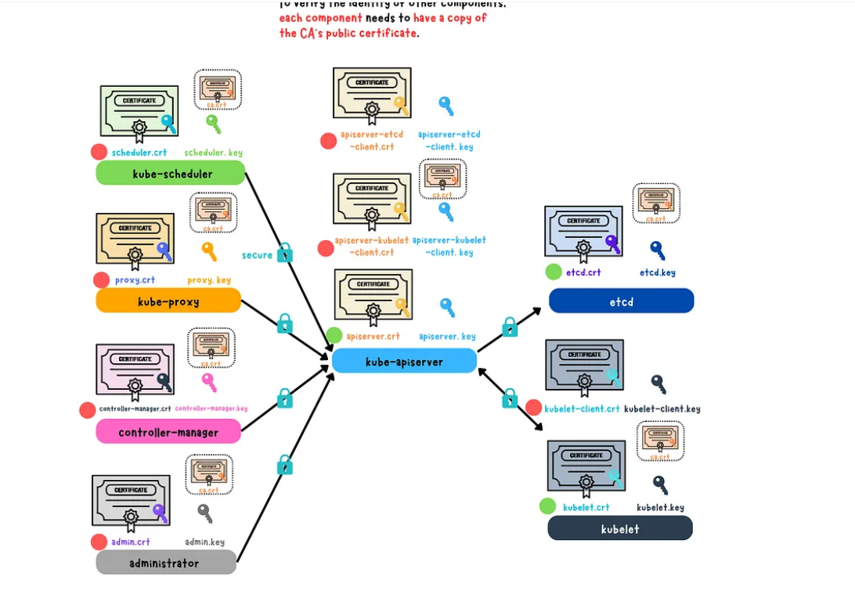
Kubernets TLS

Slide 46
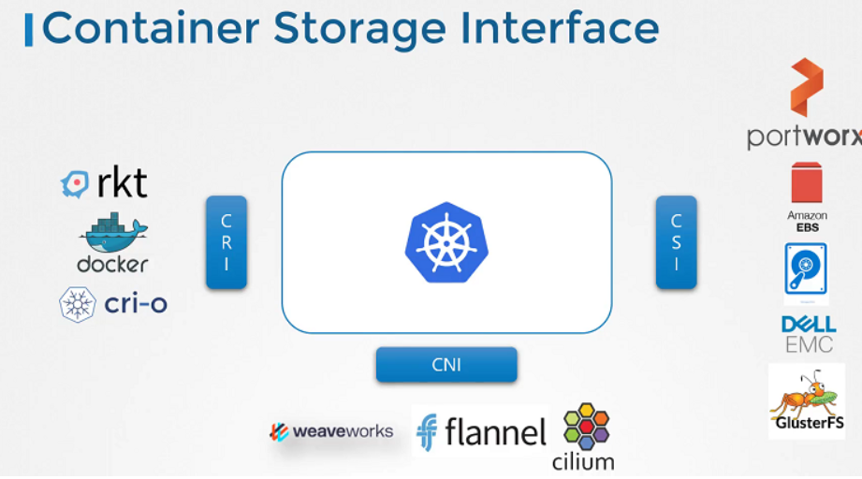
CSI

Slide 47
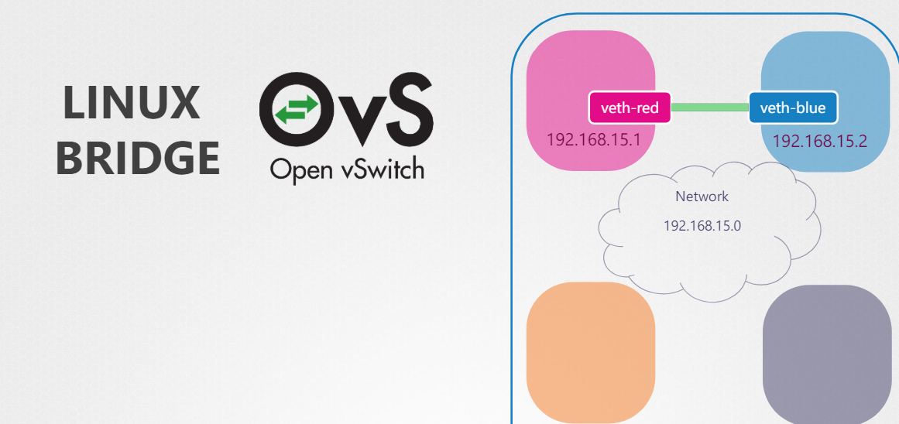
Network Namespace

Slide 48
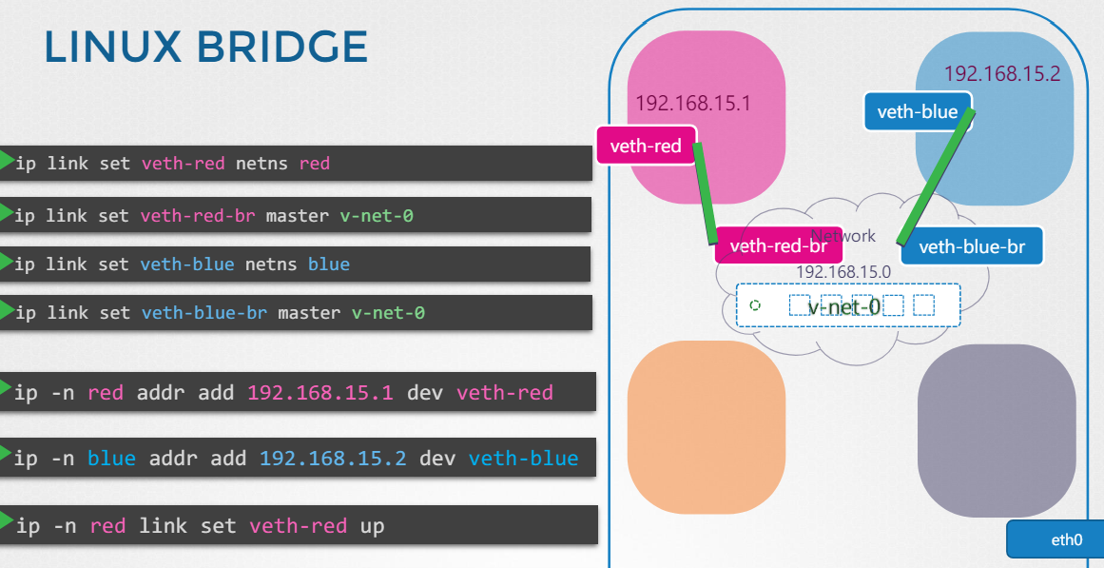
Network Namespace

Slide 49
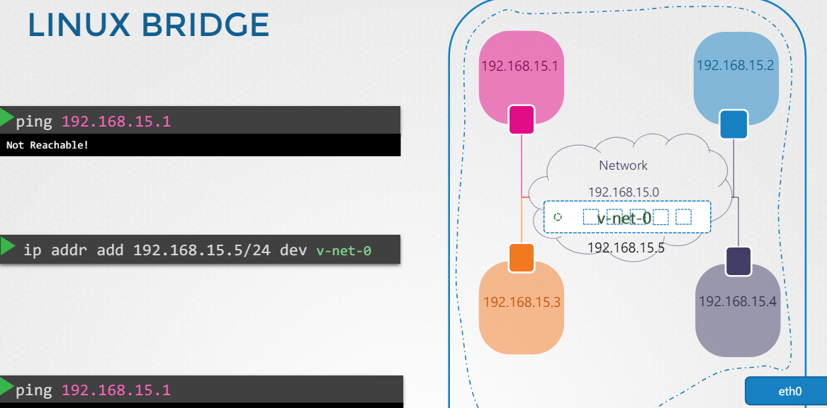
Network Namespace

Slide 50
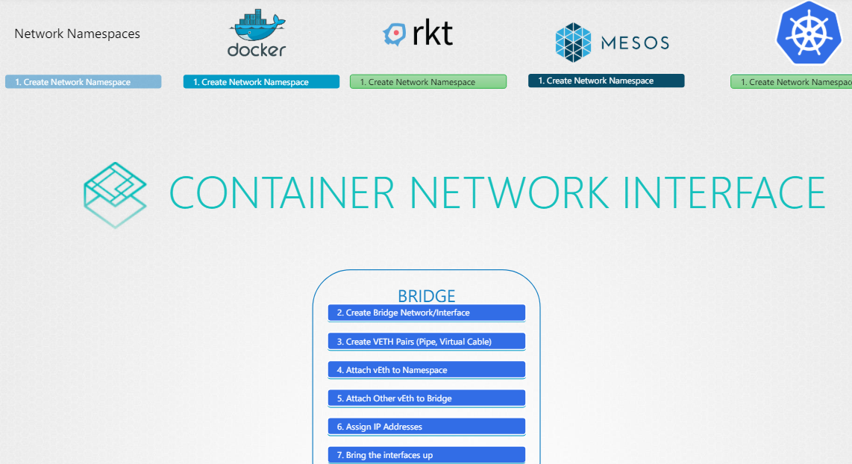
CNI

Slide 51
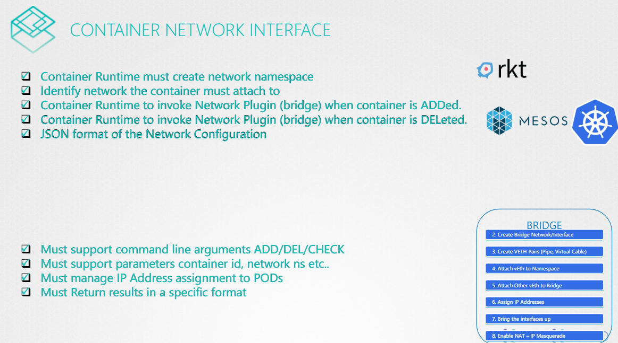
CNI

Slide 52
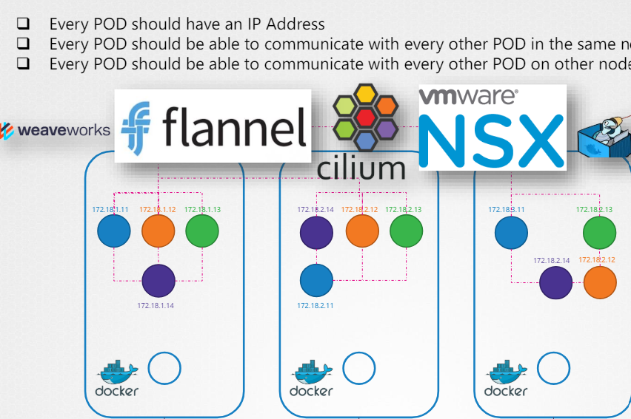
Pod Networking

Slide 53
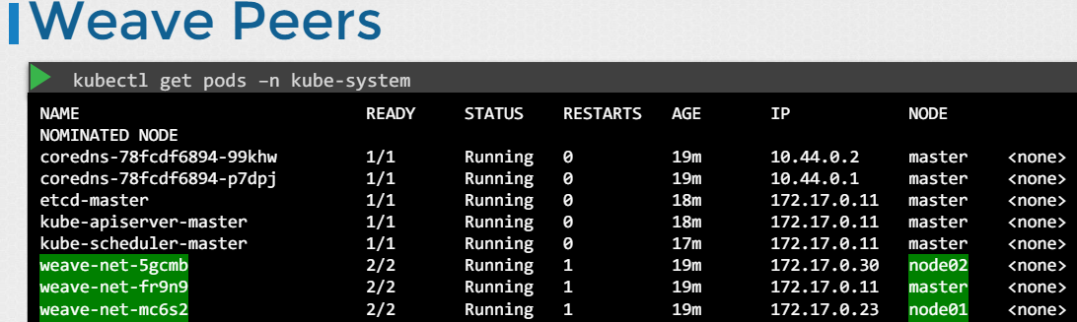
CNI Weave

Slide 54
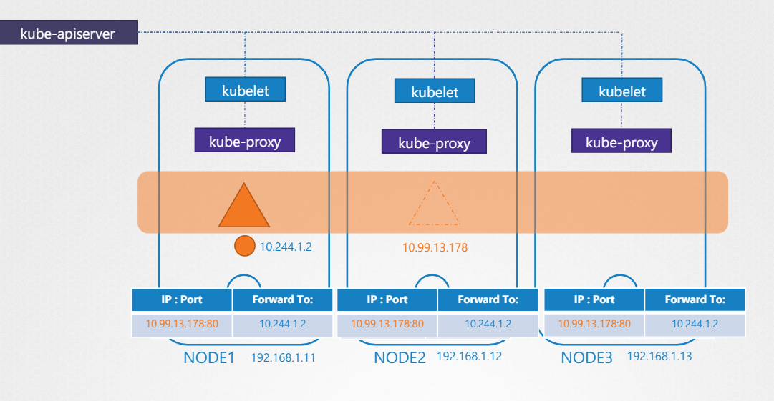
Service Networking

Slide 55
Cluster Maintenance: OS Upgrade
you might have to take down nodes as part of your cluster, say for maintenance purposes, like upgrading a software
If the node was down for more than five minutes, then the pods are terminated from that node
The time it waits for a pod to come back online is known as the pod-eviction-timeout and is set on the controller manager with a default value of five minutes
command for drain is kubectl drain node-1
kubectl uncordon node-1
you can manually mark a node cordoned using kubectl cordon node-1

Slide 56
Cluster Upgrade process
Since the kube-apiserver is the primary component in the control plane, and that is the component that all other components talk to,none of the other components should ever be at a version higher than the kube-apiserver
The controller-manager and scheduler can be at one version lower
kubelet and kube-proxy components can be at two versions lower
kubectl utility could 1 version higher, same or 1 version lower than api-server
Kubernetes supports only up to the recent three minor versions, if current is 1.29 then 1.28,1.27 are supported

Slide 57
Cluster Upgrade process
tools like kubeadm, then the tool can help you plan and upgrade the cluster
First, you upgrade your master nodes and then upgrade the worker nodes
kubeadm has an upgrade command, it will give you a lot of good information, you must upgrade the kubeadm tool itself before you can upgrade the cluster

